Slide 1

PREDICTION OF PERSONALITY TRAITS
PRESENTED BY -
TVISHA PRAKASH (4NM21CS195)
VAIBHAVI SHENOY B (4NM21CS198)

Slide 2
INTRODUCTION
What is MBTI?
The Myers-Briggs Type Indicator (MBTI) is a popular tool that categorizes individuals into 16 personality types.
Why Explore MBTI?
Self-Awareness: Understanding your MBTI type can help you identify your strengths and weaknesses, communication style, and ideal work environment.
Appreciating Differences: MBTI helps you recognize and appreciate the diverse ways people perceive and interact with the world.
Team Building: By understanding team members' MBTI preferences, communication and collaboration can be improved.

Slide 3

PROBLEM STATEMENT
Understanding Personality
Our personalities shape who we are, influencing thoughts, feelings, and actions
Traits are the building blocks, defining how we respond to situations
Harnessing Machine Learning for Prediction
This project explores using machine learning to predict personality traits
By analyzing data patterns, we aim to build a model for personality insights

Slide 4
OBJECTIVES
This project aims to leverage the power of machine learning to develop a model capable of predicting individual personality traits
Utilizing supervised learning algorithms like KNN, Logistic regression and Random forest we trained the model on a dataset consisting of labeled personality traits
By evaluating the model's performance on unseen data, we intend to assess its accuracy in predicting personality characteristics, paving the way for potential applications in various fields.

Slide 5
METHODOLOGY
Data loading
Loaded text data associated with different personality types from a CSV file
Data Preprocessing
Removed unnecessary characters like URLs, punctuation marks, extra spaces
Analyze the distribution of personality types within dataset and calculated the accuracy of different machine learning models on the T-F dimension using a training-testing split.
Feature Engineering
Text Tokenization
Text Normalization
Extracted relevant features from the text data that might correlate with personality traits

Slide 6
METHODOLOGY
Model Selection
Choose Random forest model due to its higher accuracy
User Input
Allows users to enter text, and the trained model predicts their personality type

Slide 7
RESULTS
Personality Trait | Logistic Regression | KNN | Random Forest
Introversion/Extraversion | 76.94% | 83.10% | 99.29%
Sensing/Intuition | 86.22% | 88.60% | 99.39%
Thinking/Feeling | 62.93% | 78.36% | 98.60%
Judging/Perceiving | 60.31% | 77.12% | 98.58%

Slide 8
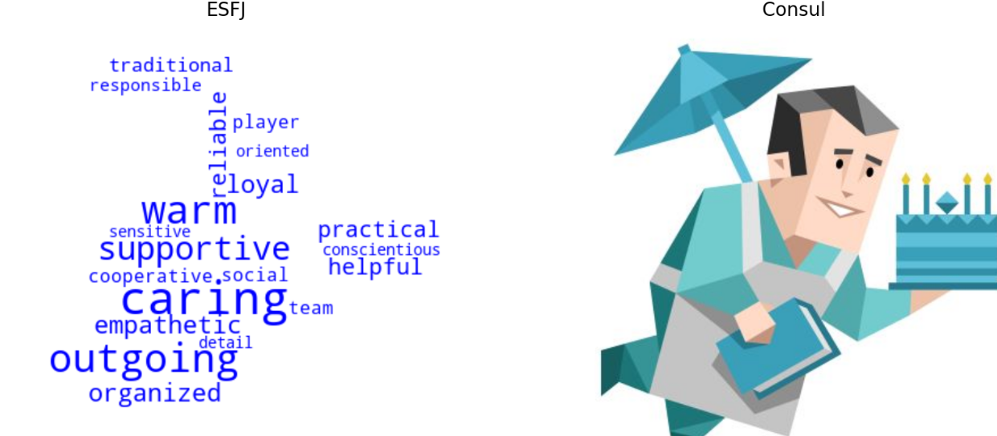
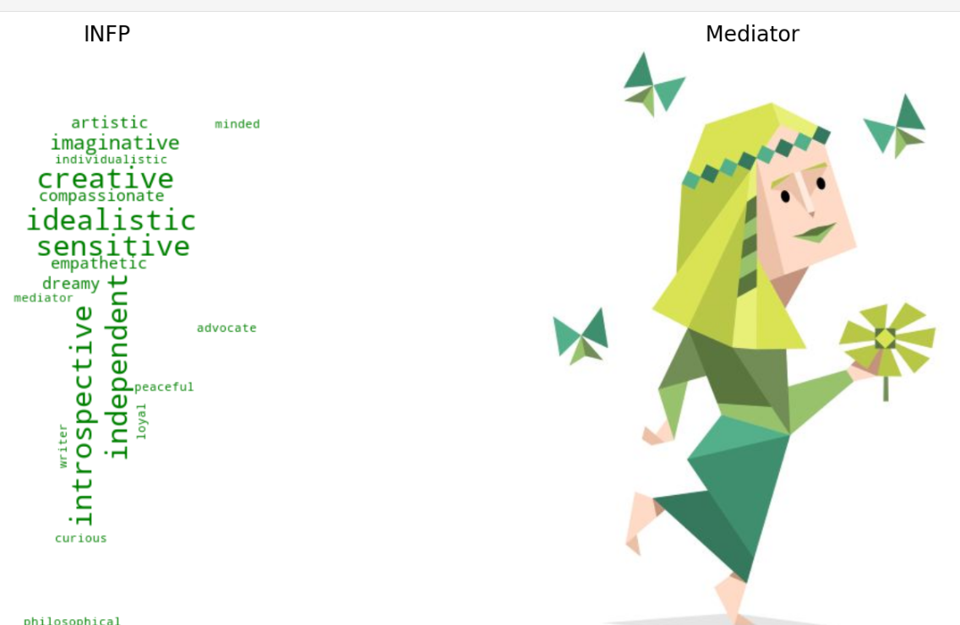
RESULTS

Slide 9
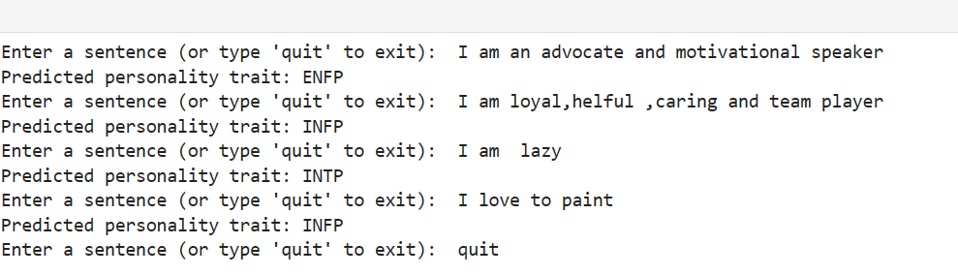
RESULTS

Slide 10
FUTURE SCOPE
Understanding Human Behaviour
Teachers Understanding Students
Optimal Group Formation
Career Guidance and Job Matching
Personalized Experiences

Slide 11

THANK YOU

